Slide 1
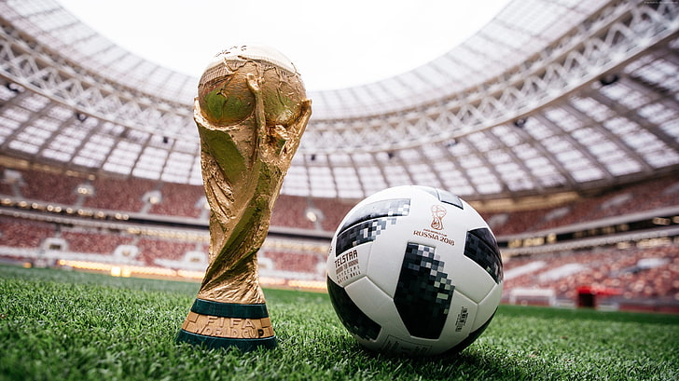
FIFA World Cup Analysis

Slide 2
Introduction
The FIFA World Cup is a global football competition contested by the
various football-playing nations of the world. It is contested every four years
and is the most prestigious and important trophy in the sport of football.
The Report will show key metrics and factors that influence the World Cup
win.

Slide 3
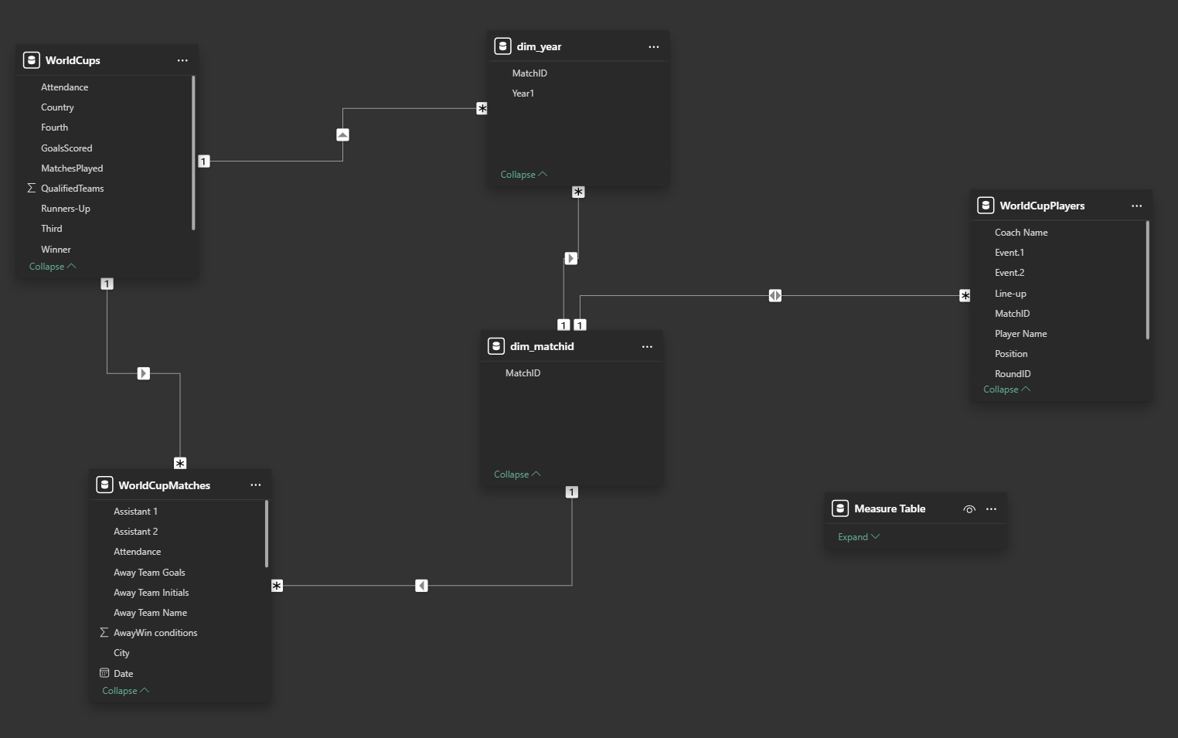
Details of Data

Slide 4
Main KPIs
Find out the Team wining the Gold, Silver and Bronze most
Total Goal, Matched, Team Qualified in the Worldcup
Match Schedule by Group/Stage/Stadium/City/Date/Time
Match performance by Coach/Player/Event
Count of Lost/Win/Draw by a Team .Which Team remain Undefeated by Match Performance

Slide 5
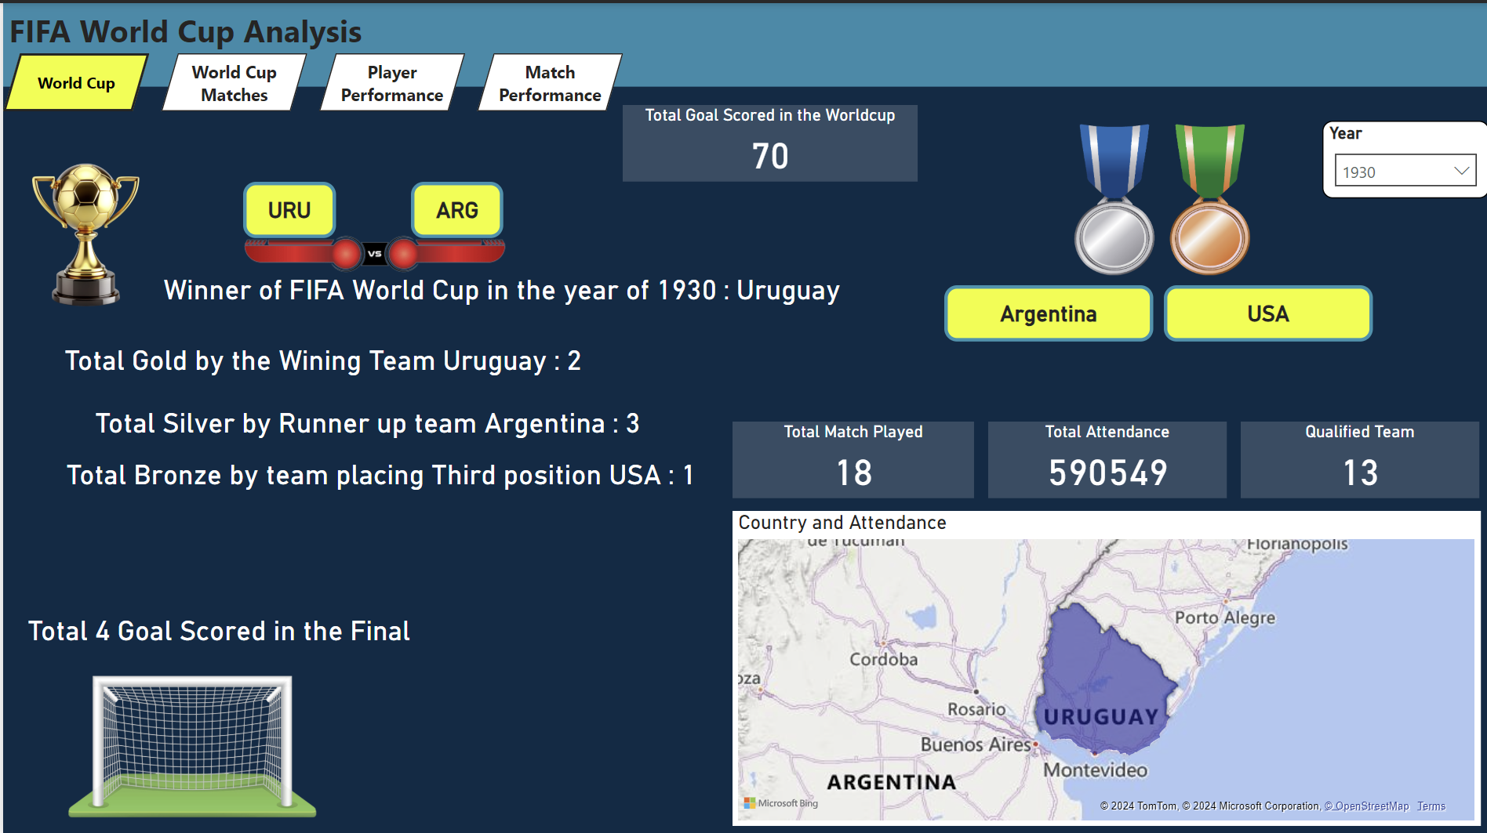
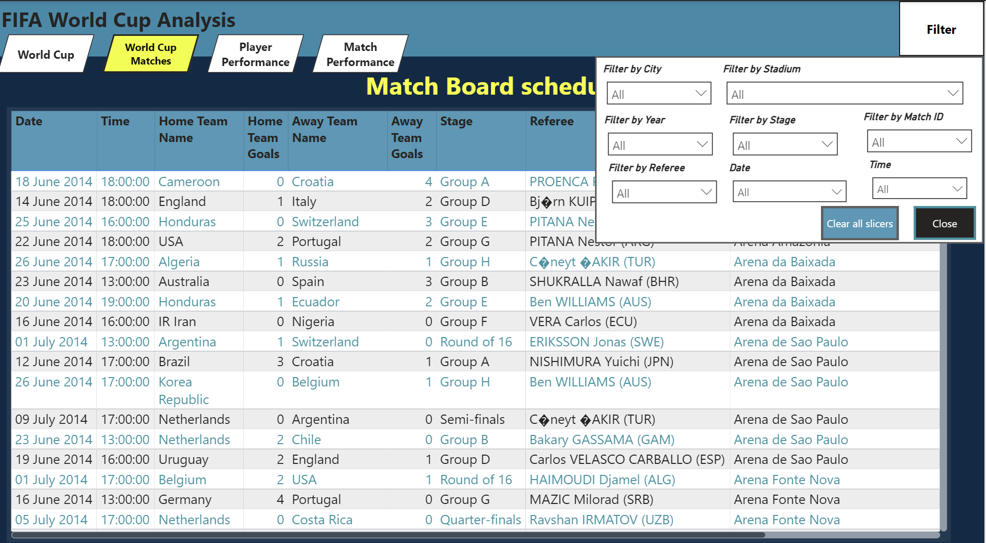
My Design

Slide 6
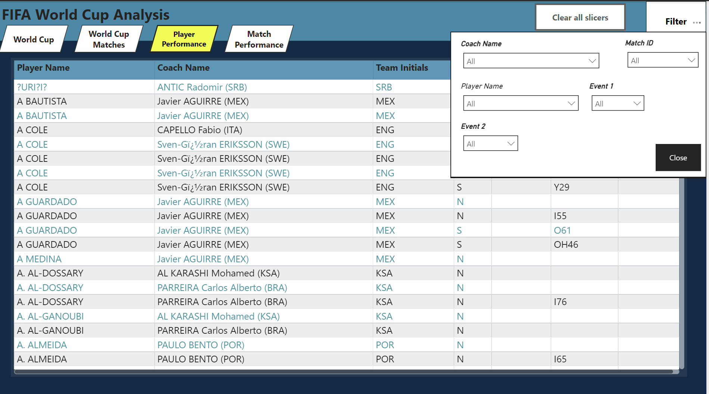
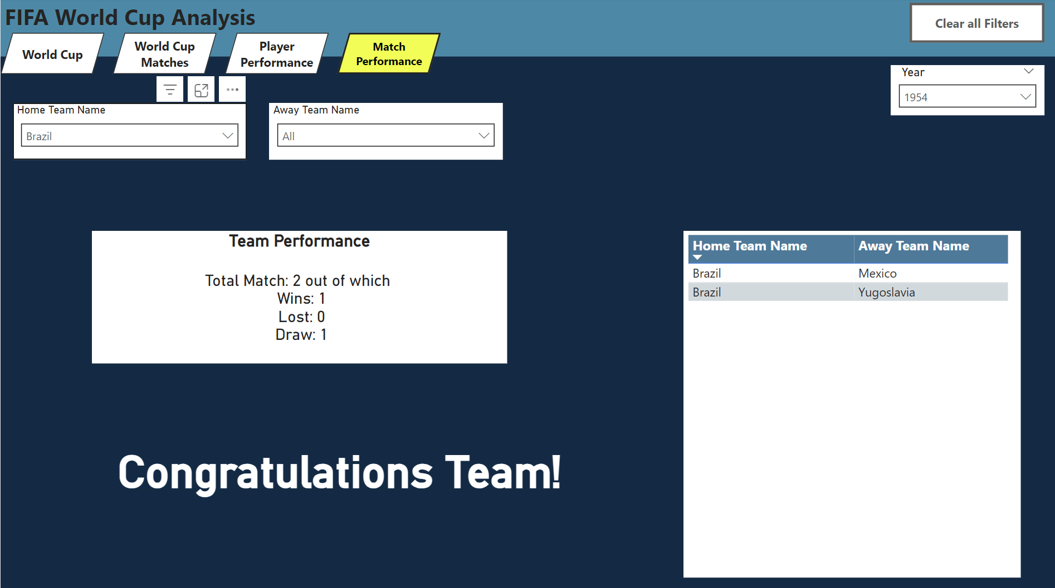
My Design

Slide 7
Thank you

